Slide 1


EMPOWER YOUR BODY, ELEVATE YOUR MIND

Slide 2
TOPICs
Introduction
Features
Functionality
Working
Graph representation
Flowchart
Technologies Involved
Conclusion

Slide 3

INTRODUCTION
Welcome to ZenFit Nexus: The ultimate Health and Fitness tracker guide. This will enable clear and achievable wellness goals to guide your journey. Utilize this tool to monitor progress of your wellness journey.

Slide 4

features
Calorie Burn Tracking
Calorie Intake Tracking
Exercise Recommendation
Nutrients Intake Tracking
Easy to Use
WhatsApp Chatbot
Graph of Daily Activities

Slide 5
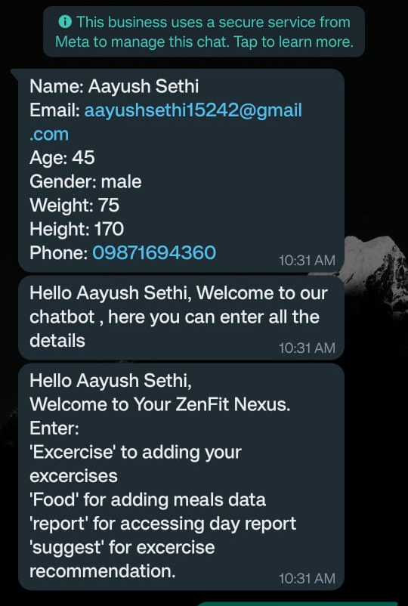
Functionality
We are using a chatbot on WhatsApp where we maintain all our records of food intake along with nutrient intake and calories burned through exercises , and recommends various different exercises that can be done at home.

Slide 6
Working
We are taking data from user in the form of message that what they have taken and what exercise are we doing.
The user has to enter the exercise which he will perform and the time for which he shall be doing it/can also specify the distance covered by the person.
For food intake the user shall be mentioning the food he ate along with the quantity, for which accordingly the calories will be calculated.
The user can select a particular muscle that they want to train and the bot will recommend the exercises which can be performed at the comfort of their homes.

Slide 7
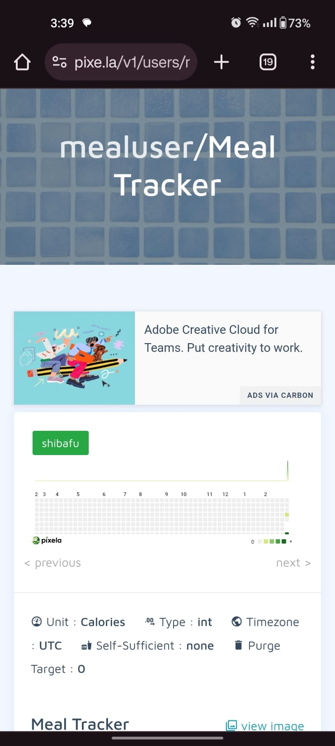
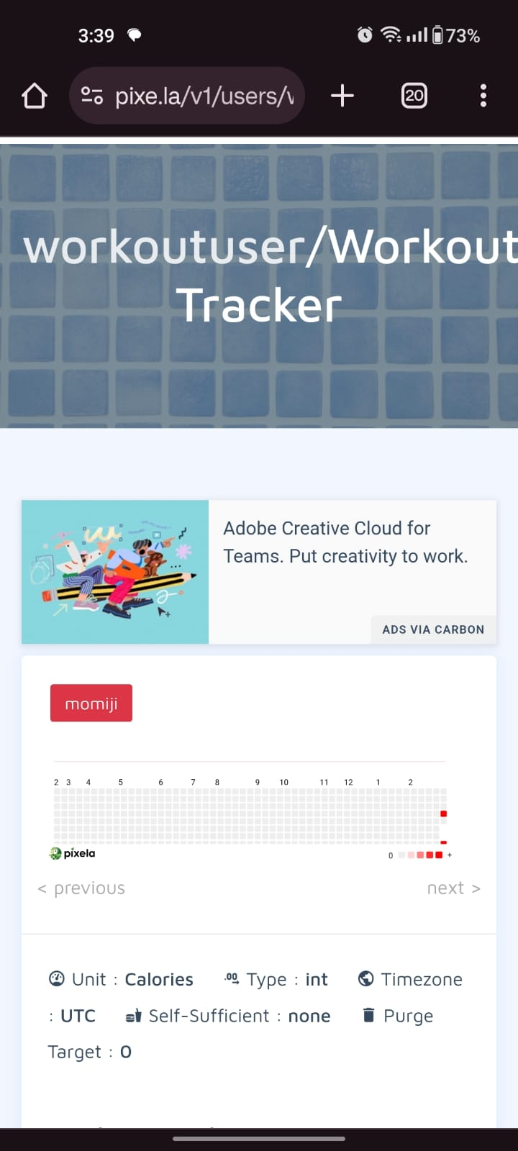
GRAPH

Slide 8
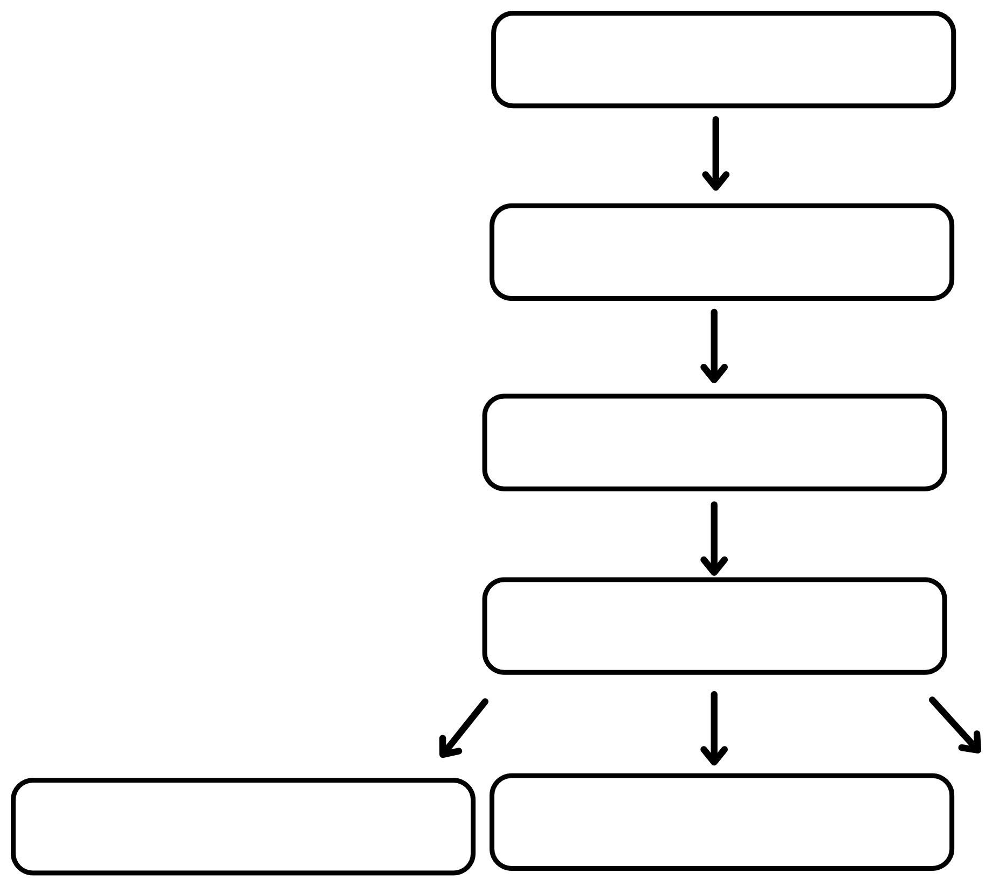

Flow chart
COLLECTING USER DATA
WHATSAPP CHATBOT
USER FOOD AND EXERCISE TRACKING
CALORIES INTAKE AND BURNED
NUTRIENT INTAKE TRACKING
DAILY CALORIE GRAPH
EXERCISE RECOMMENDATION

Slide 9
TECHNOLOGIES INVOLVED
Python
Flask application
Python API Modules
HTML
CSS
JavaScript
Bootstrap

Slide 10
conclusion
With the guidance of our ZenFit Nexus is a tracker , you can embrace healthier and more active lifestyle . By incorporating the insight and recommendation from your tracker , you can make positive changes that contribute to your overall well-being.

Slide 11
Thank you
AAYUSH SETHI
RAJKUMAR BANSAL
VARUN SINGLA
ANJAN NARULA

